Slide 1
QR-Based Visitor Access
Management System (VAMS)
TEAM MEMBERS
Anant Kumar Jain (24EARAD011)
Ansh Soni (24EARAD016)
Ashish Kumar Swami (24EARAD024)
Bhavesh Sharma (24EARAD030)
Deepanshu (24EARAD036)
PROJECT GUIDE
Er. Ram Babu Buri

Slide 2

Operational Bottlenecks & Vulnerabilities
"Traditional paper-based visitor management causes operational bottlenecks and security vulnerabilities."
Paper Registers & Entry Delays
Manual Entry Points: Relies heavily on handwritten paper logs and manual security intercoms.
Peak-Hour Congestion: High visitor volume leads to severe queue delays and slow verification processes.
Identity Verification Risks: Susceptible to forged identities, illegible entries, and unverified credentials.
Temporary Visitor Overhead: Managing couriers, contractors, and delivery personnel manually creates severe security gaps.
Occupancy & Audit Vulnerabilities
Untracked Overstays: Zero automated alerts or tracking mechanisms when visitors remain beyond allowed times.
No Real-Time Visibility: Lacks centralized facility occupancy data during emergency or routine operations.
Absence of Digital Audit Trails: Historical access records are fragmented, unsearchable, or easily damaged.
Management Complexity: Administrative overhead increases exponentially without centralized software control.

Slide 3
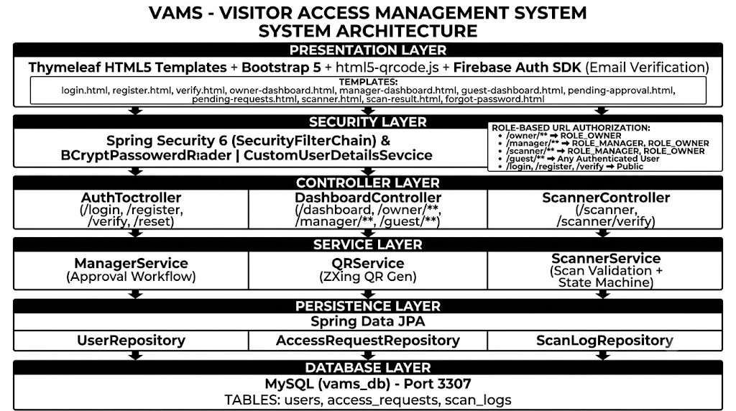
System Architecture & Tech Stack
Layered enterprise architecture with robust Java Spring Boot backend
Enterprise Design: Separates presentation, security, controller, service, and persistence layers.
Key Benefits: Platform independence, strong type safety, and stateless scan processing for horizontal scalability.
Presentation: Thymeleaf & Bootstrap 5
Security: Spring Security & Firebase Auth
Core Stack: Java 17 & Spring Boot 4.1.1
Logic Layer: Controller & Service Workflows
VAMS End-to-End System Architecture
Detailed interaction across Presentation, Security, Controller, Service, Persistence, and Database layers.
Persistence: Spring Data JPA with Hibernate
Database: MySQL 8.0 Engine

Slide 4
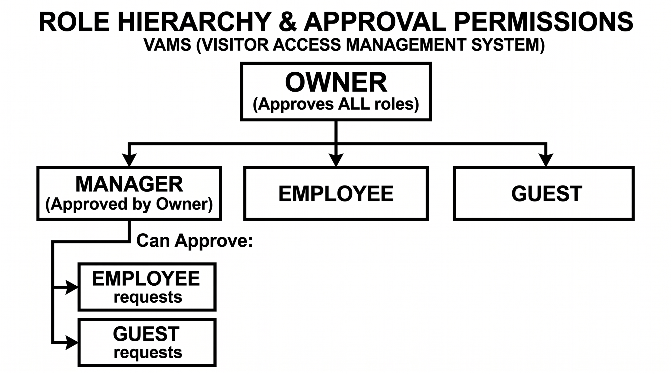
VAMS Architecture & Security
Role-Based Access Control (RBAC)
A hierarchical approval workflow ensures secure, role-based access provisioning.
Role Hierarchy & Governance
Owner: Unrestricted system control. Approves all roles and grants RESTRICTED access.
Manager: Approved by Owner. Reviews and approves Guest or Employee requests, granting PUBLIC access.
Pending State: All unapproved users remain blocked until validated.
Approval & Permission Structure Diagram
Time-Bound Access Validity
Access duration can be precisely configured to enforce time-bound security for temporary staff and visitors:
ONE_DAY : Single-day access pass for temporary visitors.
UNTIL_LOGOFF : Active session duration until manual/auto sign-out.
ONGOING : Continuous role access for permanent staff.
Workflow Key:
• Owner maintains primary authority over Manager, Employee, and Guest roles.
• Manager acts as delegated approver for lower-tier role requests.

Slide 5
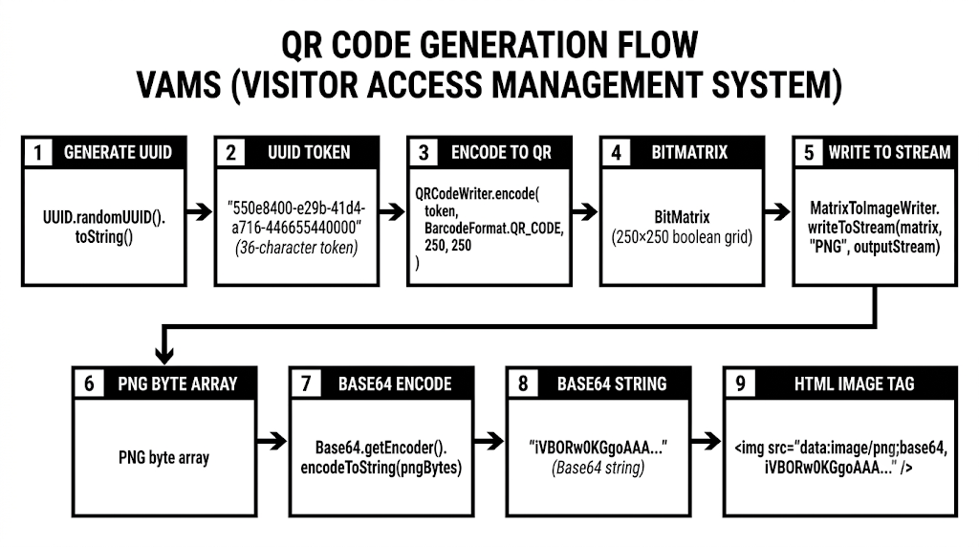
QR Token Verification Framework
Sub-second, multi-gate access control via secure tokens
Token Generation & Scanning
UUID v4 Token: System generates a cryptographically random 128-bit UUID v4 upon approval.
ZXing Encoding: Google ZXing library encodes token into Base64 PNG format.
HTML5 Scanning: Gate security uses browser-based HTML5 camera scanning to validate tokens.
Gate Verification & Logic
Sub-Second Execution: Rapid database lookups verify token timestamp validity instantaneously.
Anti-Passback Rules: Strictly enforced through an automated ENTRY/EXIT state machine.
Audit Logging: Every scan generates immutable audit logs for complete access traceability.

Slide 6


Visitor Management Solution (VAMS)
System Advantages & Technical Considerations
KEY ADVANTAGES
TECHNICAL CONSIDERATIONS
Automated Registration & Approvals: Streamlines visitor entry through automated workflows and strict Manager approvals.
Real-Time Tracking: Enables live building occupancy tracking and simultaneous multi-gate monitoring across facilities.
Microsecond Audit Logs: Employs precise DATETIME(6) timestamps to guarantee accurate, tamper-resistant audit trails.
Paperless Efficiency: Significantly reduces manual paperwork while enhancing perimeter security.
Network Dependency: Requires continuous network connectivity for real-time validation and cross-gate synchronization.
Hardware Prerequisites: Dependent on dedicated, camera-equipped scanning devices deployed at all designated entry points.
Operational Continuity: Fallback procedures must be established to handle temporary network disconnections or hardware maintenance.

Slide 7

3-Tier Visitor & Access Management System (VAMS)
System Overview
Centralized Digital Access
VAMS replaces manual paper registers with a secure, centralized digital solution designed to regulate building entry and exit.
3-Level Structure
Operates across Owner, Manager, and Client/User roles to enforce role-based access for Public or Restricted areas.
Core Capabilities
Automated visitor registration
Hierarchical approval workflows
Precise entry and exit tracking
Technology Stack
Java 17 Spring Boot MySQL
Digital Kiosk & Gate Control
Automated QR registration & role-based access validation

Slide 8
SYSTEM EVALUATION & QUALITY ASSURANCE
System Testing & Performance Verification
Performance Metrics & Benchmarks
100%
PASS RATE ACROSS ALL MODULES
Validated across 24 rigorous automated & manual test cases
<180ms Gate Verification Latency
Average gate verification response times consistently measured under 180 milliseconds during live test cycles.
Comprehensive Test Scope
Rigorous evaluation executed across four core testing tiers to ensure enterprise reliability:
Unit & Integration: Core logic & API workflows
Functional Testing: Registration & Authorization
Security & Validation: QR validation & access control
Concurrency: Multi-gate simultaneous load
Zero Concurrency Anomalies
Zero race conditions or access anomalies recorded during heavy simultaneous multi-gate access operations.
Production & Enterprise Readiness
System architecture demonstrates high stability, low latency, and robustness necessary for enterprise deployment.

Slide 9
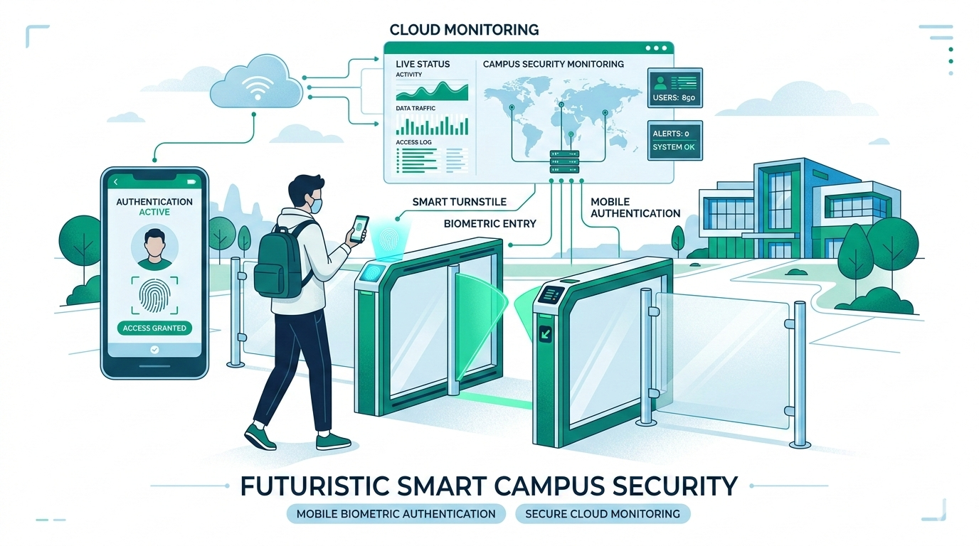
Scalable Foundation & Future Enhancements
Biometric, Cloud, and Hardware Integrations
System Evolution
VAMS successfully replaces manual logs with a secure, centralized digital platform, establishing a robust framework for next-generation security upgrades.
Planned Enhancements
Dedicated Mobile Applications: Developing native apps for seamless user check-ins and pass management.
Biometric & Cloud Integration: Implementing facial/fingerprint recognition and cloud databases for remote monitoring.
Hardware & Real-Time Alerts: Expanding to automated turnstile gate hardware with real-time SMS/email access alerts.
Smart Campus Architecture
Conceptual layout for mobile authentication, turnstile control, and cloud monitoring integration.

Slide 10
Thank You !!!
Questions & Answers

